Slide 1
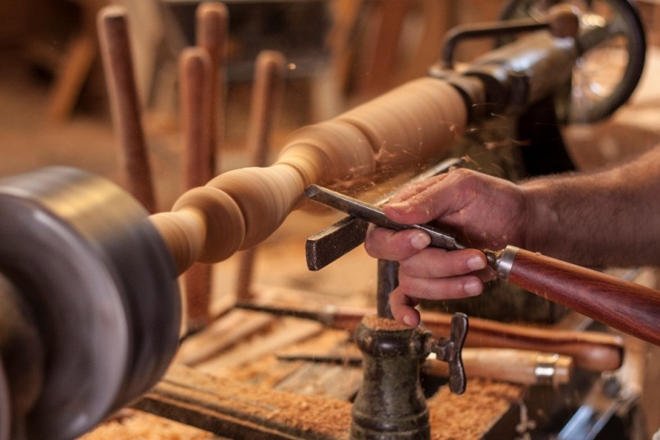
Nat5 design & Manufacture
Woodturning Lathe

Slide 2
Learning intentions & success criteria
Learning Intentions
Overview of the woodturning lathe, its safety practices, tools and processes.
Success Criteria
State the safe working practices when using a woodturning lathe.
Name and describe the components, tools and processes in the use of the woodturning lathe.

Slide 3
What is a woodturning lathe?
The woodturning lathe is a machine tool used with hand held tools to shape a piece of wood symmetrically around a central axis of rotation.
Example of products could include: stair spindles, baseball bats, bowls etc.

Slide 4
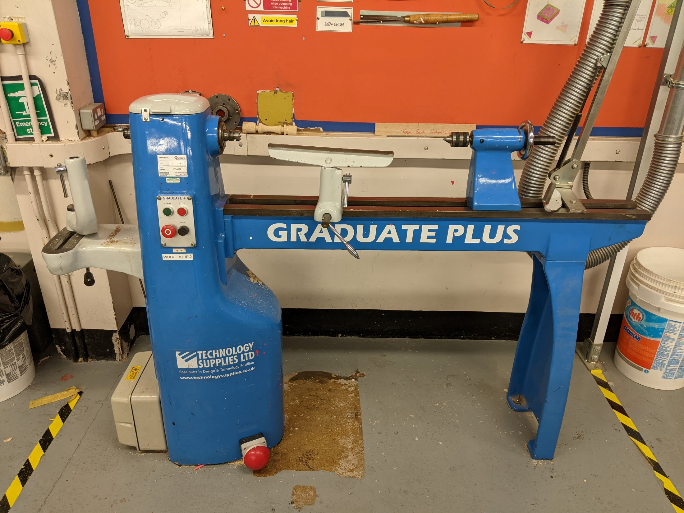
?
Headstock
Revolving Centre
Forked Centre
Bed
?
Faceplate
Tool Post
Tool Rest
On/Off Switch
Speed Control
Tailstock
Parts of a Woodturning Lathe

Slide 5
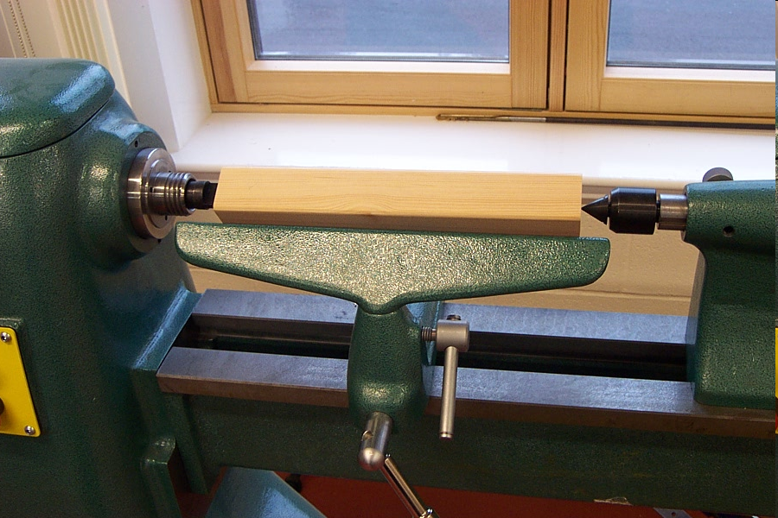
?
When turning between centres, the work piece is held between a Forked Centre and a Revolving Centre
?

Slide 6
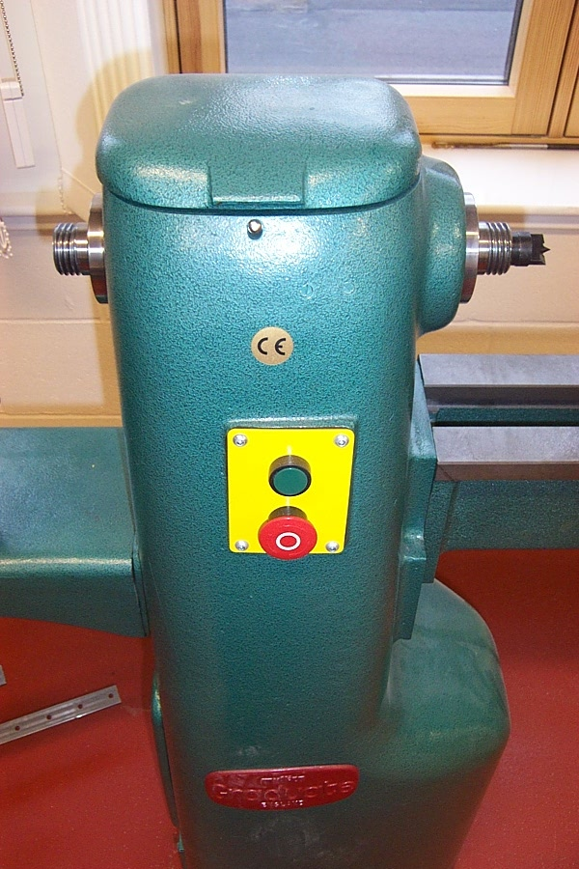
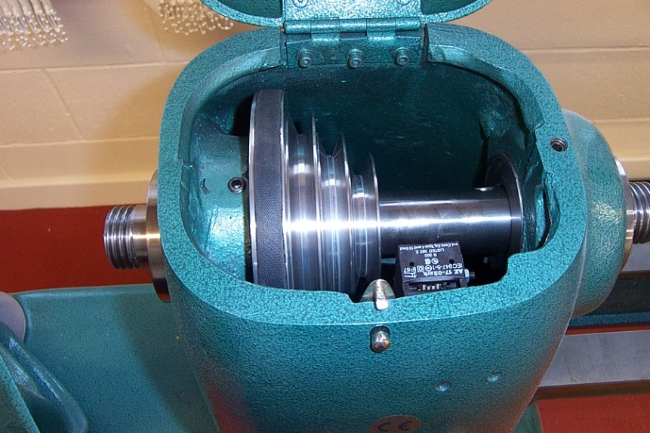
?
Headstock
This supports one end of the work piece.
It contains the driveshaft as shown below.
?

Slide 7
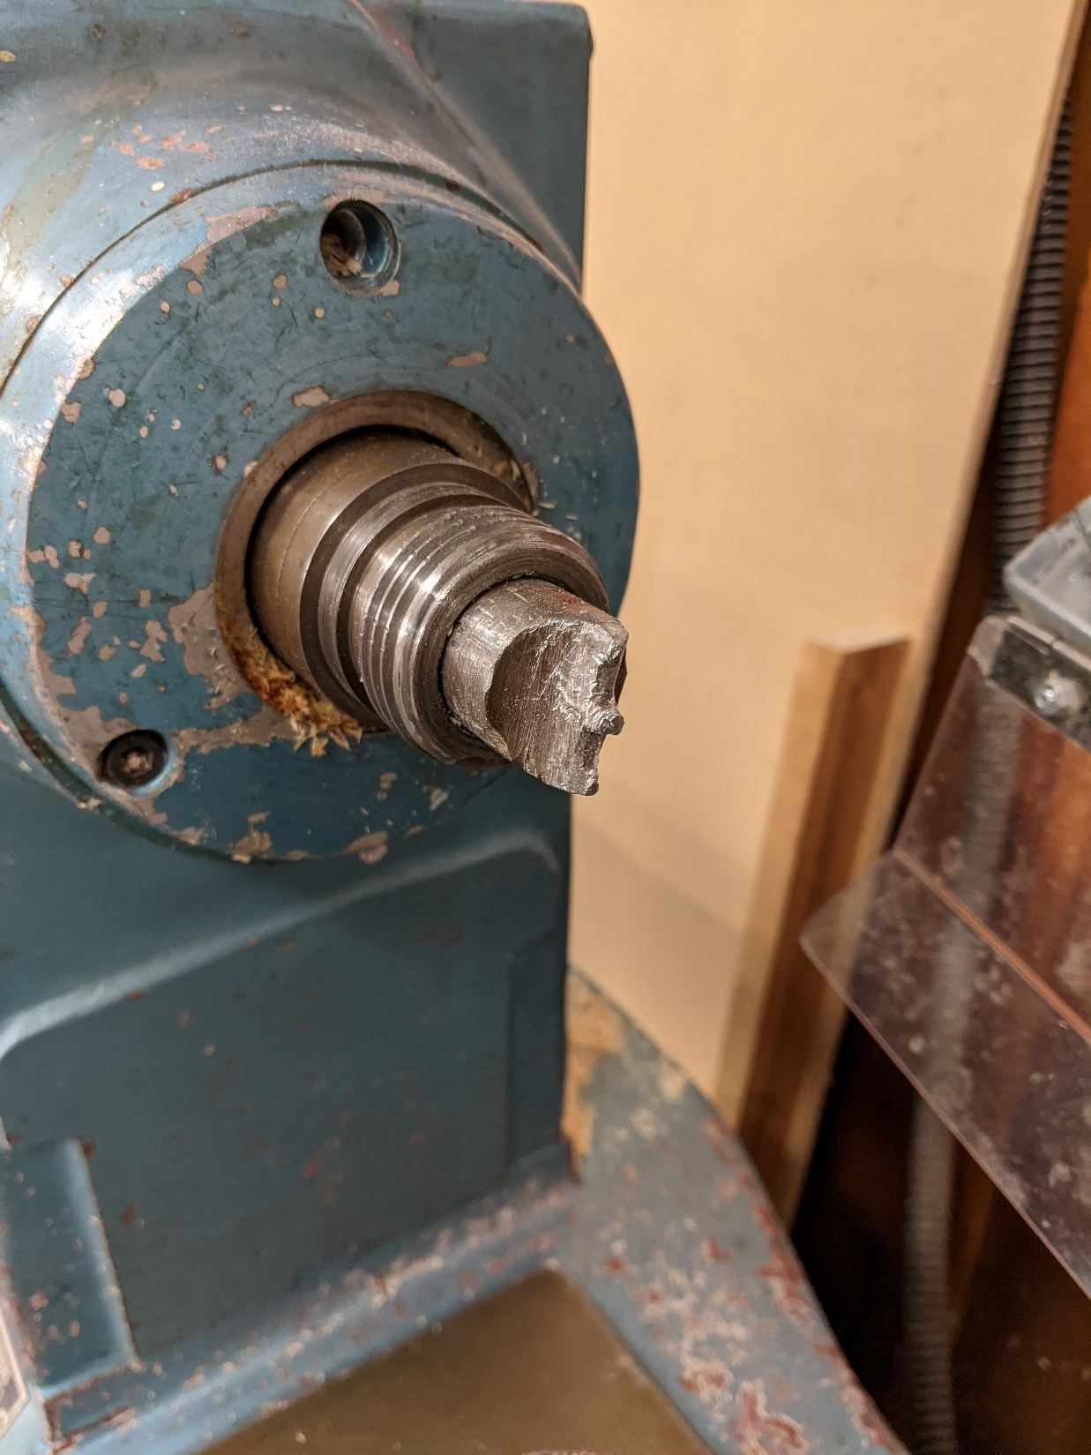
Forked Centre
The Headstock can be fitted with a Forked Centre to support one end of the work piece when turning between centres.

Slide 8
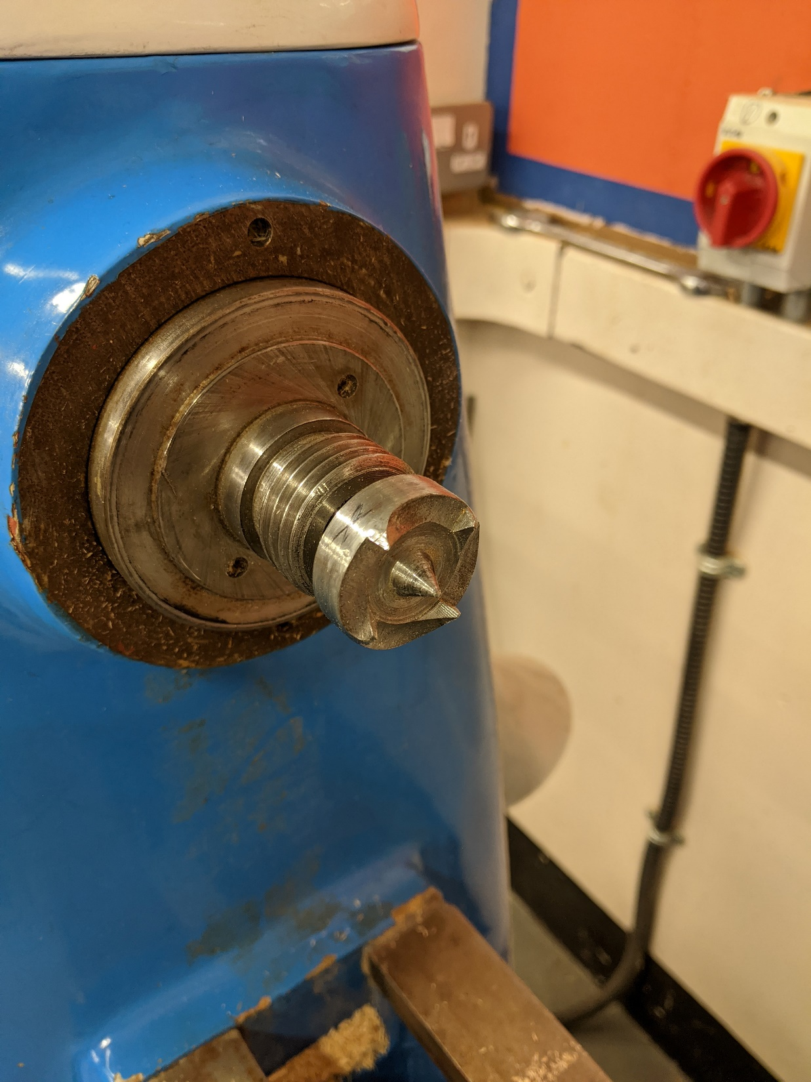
Butterfly Centre
The Headstock can be fitted with a Butterfly Centre to support one end of the work piece when turning between centres.
This provides a greater grip that a forked centre.

Slide 9
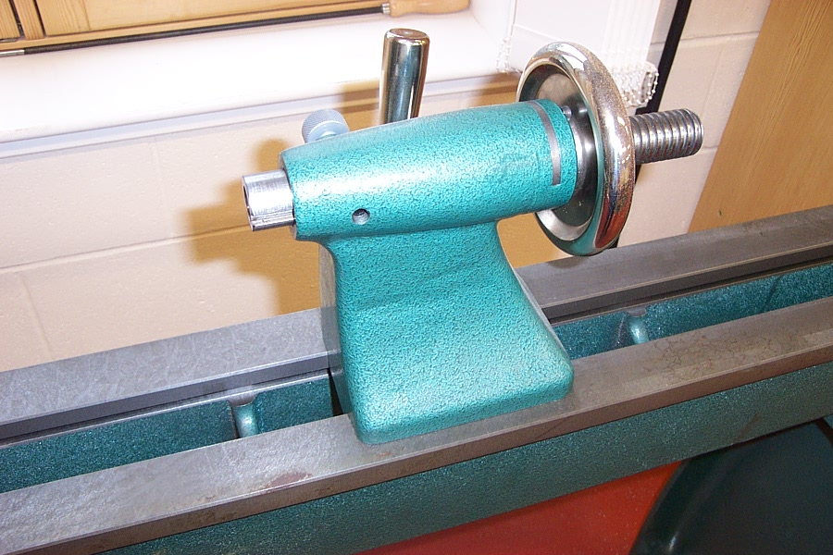
Tailstock Locking Lever
Tailstock
The tailstock supports the other end of the work piece.
Hand Wheel
Bed

Slide 10
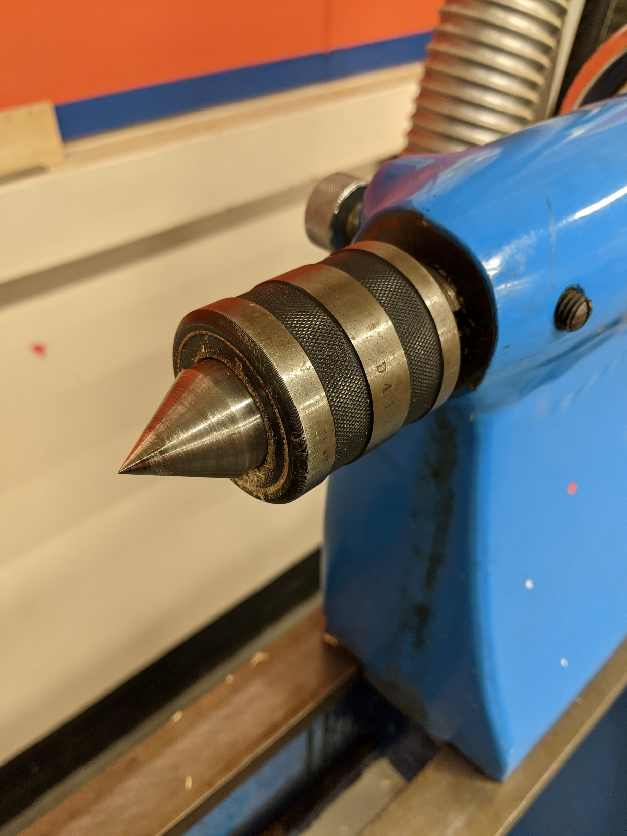
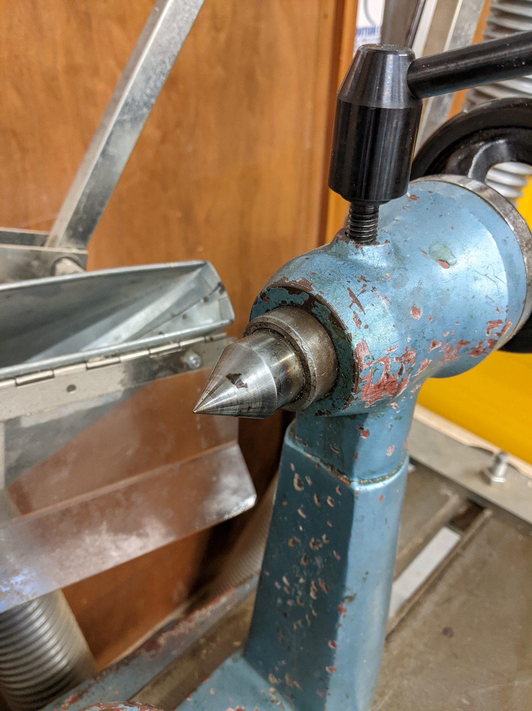
Revolving Centre
Dead Centre
Revolves as the wood turns.
Remains fixed, therefore friction may occur. Use wax to lubricate the centre.

Slide 11
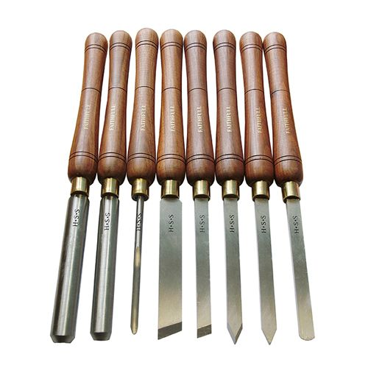
Woodturning tools
Wood turning tools are used to shape the work piece.
Depending on what shape is required will ultimately determine what type of tool will be used.
The tool rest is used to support the tools while shaping is being carried out.

Slide 12
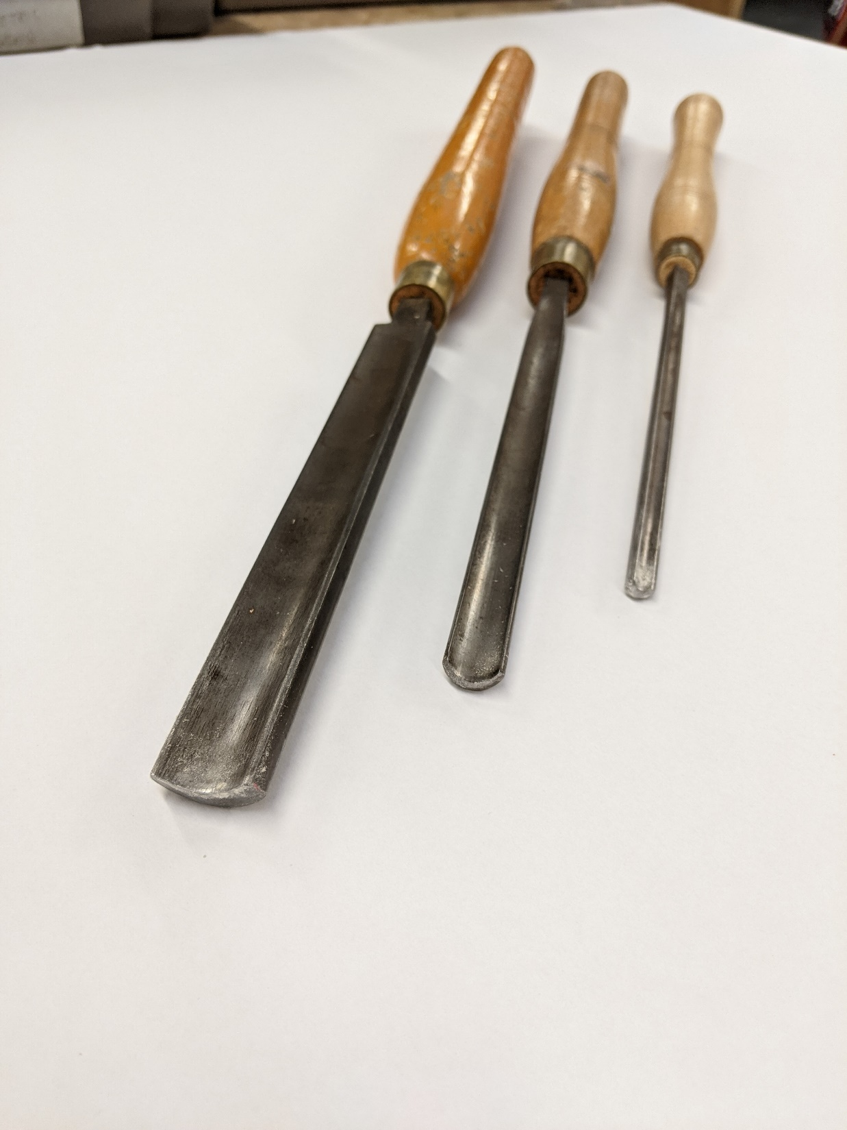
GOuge
The Gouge utilises a slicing action and can be used for both roughing down and fine finishing.
Cross Section

Slide 13
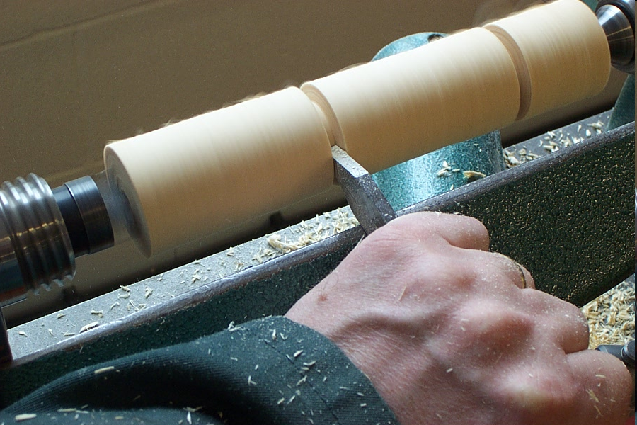
Parting chisel
The parting tool can be used to cut narrow slots in your work piece. It creates a gap in the wood and is used to cut off a section of the wood to an exact length (part off).

Slide 14
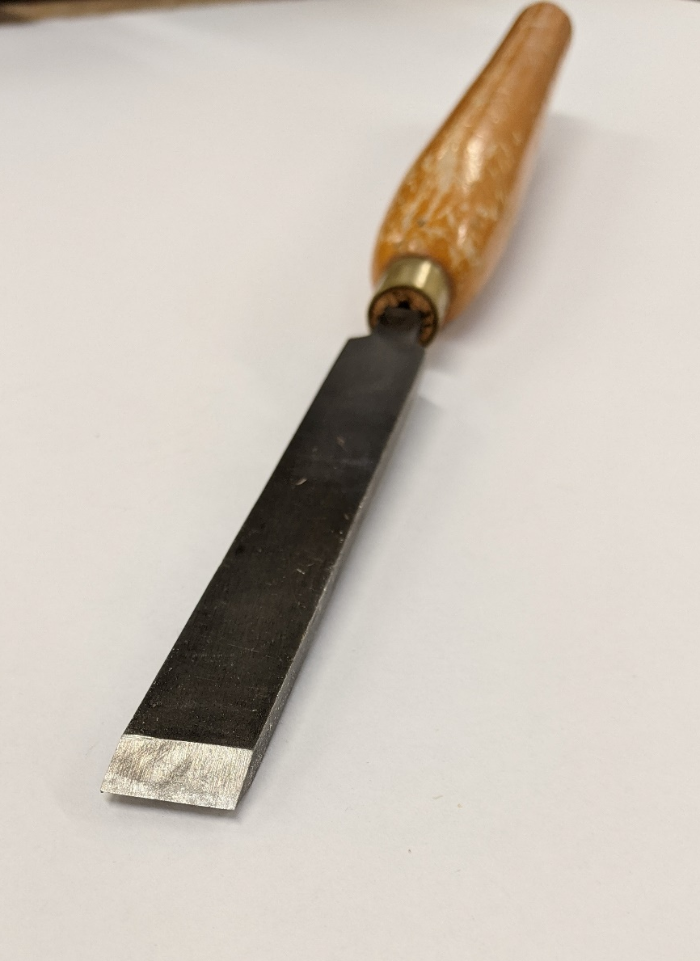
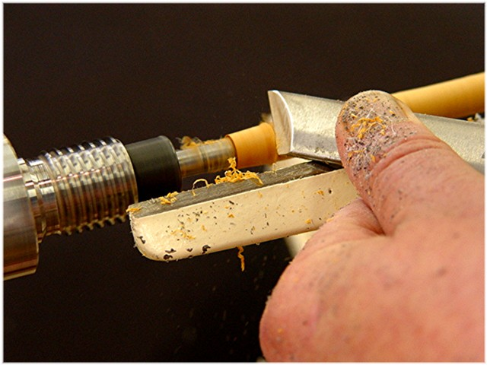
Skew chisel
The skew chisel can be used to produce a very smooth finish. They are basic chisels used in spindle turning for cutting beads, shearing the ends of boxes or cylinders and smoother the edges.

Slide 15
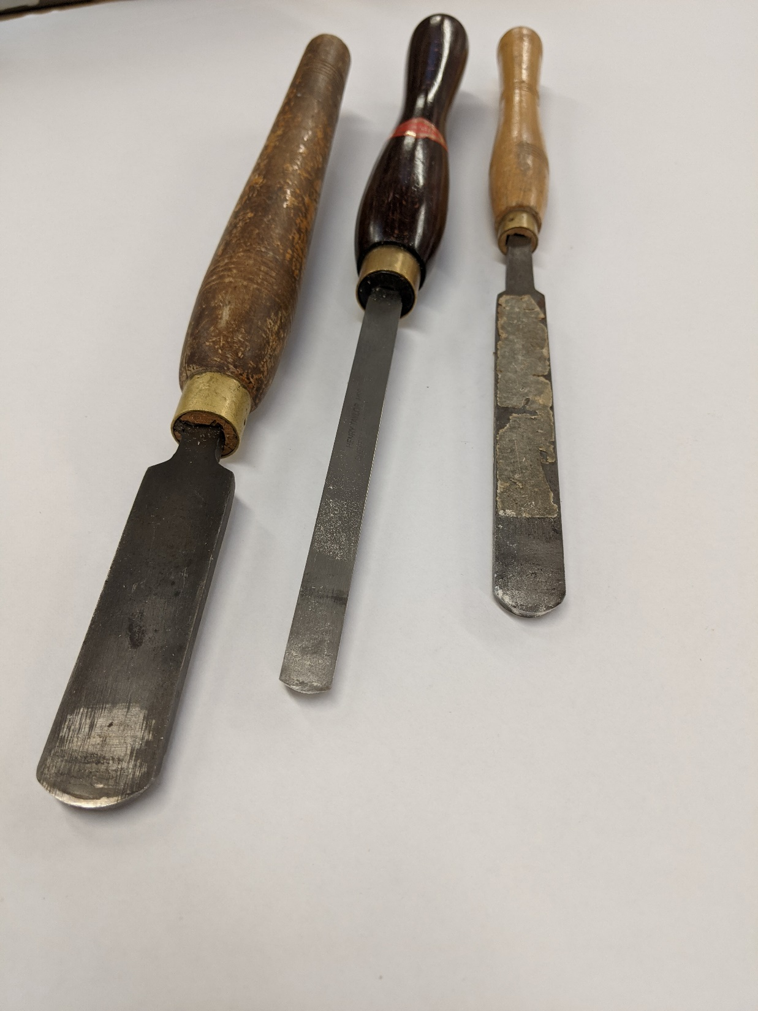
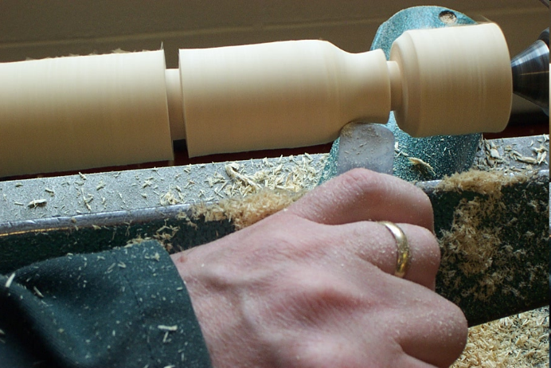
scraper
Scrapers are among the easiest lathe tools to use however as the name suggests the tool scrapes rather than cuts and can leave a rather rough finish.
Scrapers are available in a wide range of shapes and sizes.

Slide 16
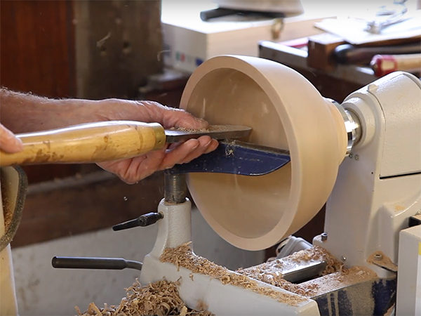
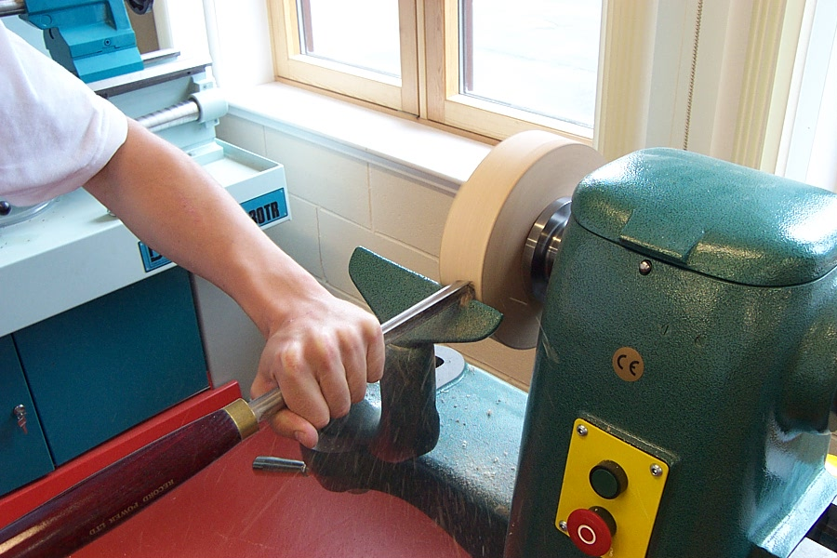
faceplate
A Faceplate is used to attach a wood blank to the lathe when making, for example, a bowl.

Slide 17
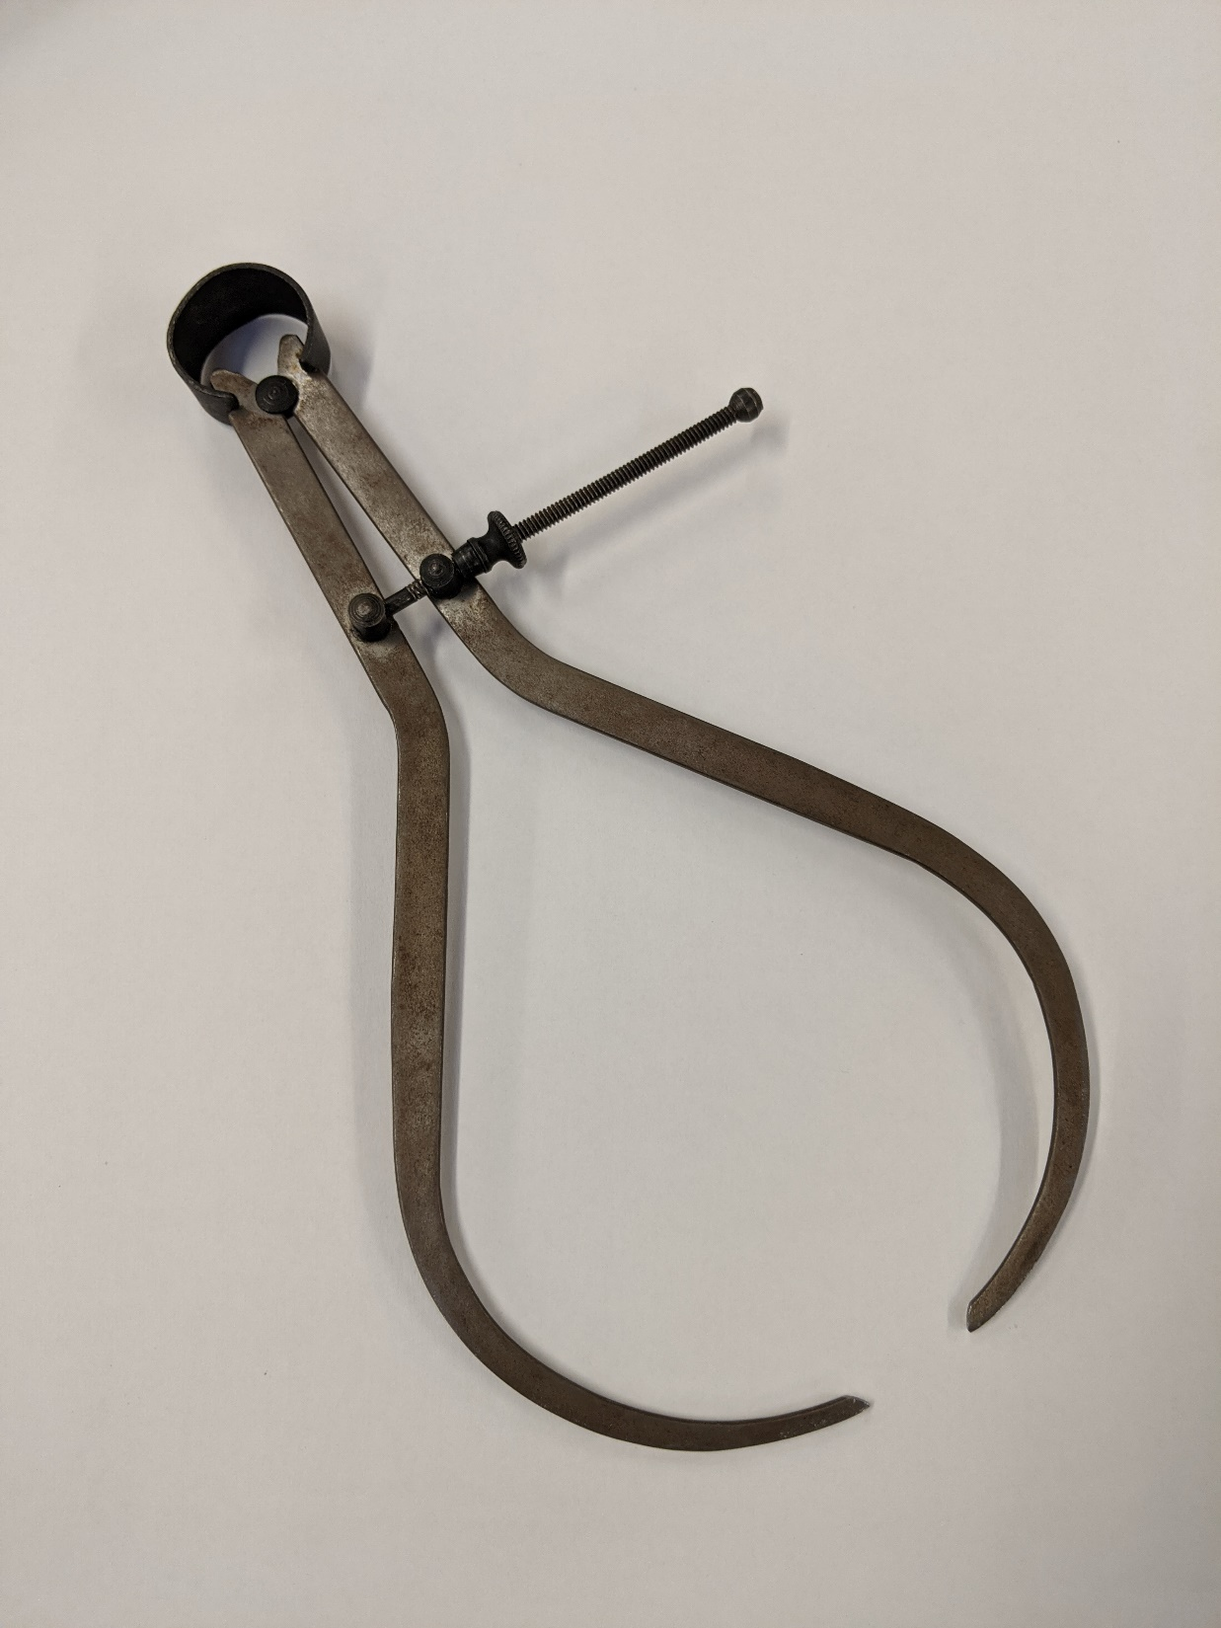
Outside callipers
The callipers are used to check the outside diameter of various objects.
Once set, the size between each leg can be read using a steel rule.

Slide 18
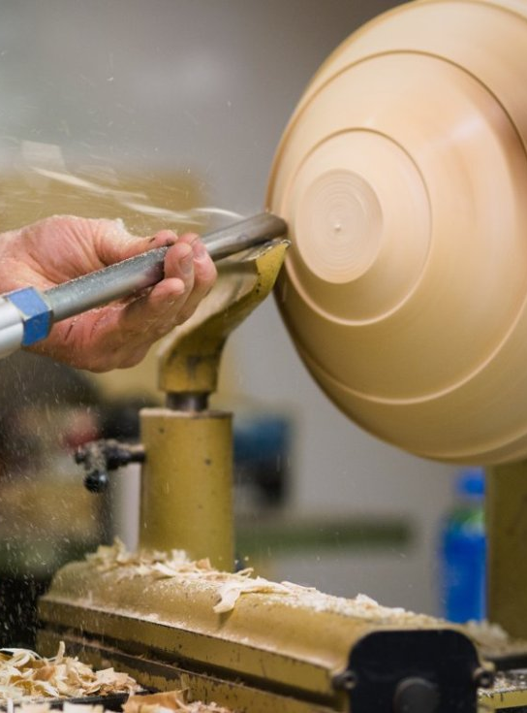
Preparing a blank for turning
The wood lathe is a machine used to create cylindrical objects in wood, i.e. wooden bowls, table legs, etc.
A piece of wood is secured between two points called the HEADSTOCK and the TAILSTOCK.
The HEADSTOCK has a motor
enclosed and is therefore the end which actually turns the wood.
The surface finish of the wood being turned can be improved by increasing the speed of the lathe.

Slide 19
Preparing a length of wood for turning
Use Tenon Saw to cut a diagonal groove to one end of the piece of wood. This helps the centre prongs to grip the piece of wood
1.
3.
2.
The drive centre is hammered into position at the grooved end using a mallet
4.
Using compass, draw circle to mark in shape
5.
6.
Remove waste wood using suitable plane

Slide 20
Marking out and turning
After preparing the wood for turning, there are a number of processes to be carried out to make your final product (e.g. the coat pegs you have been working on).

Slide 21
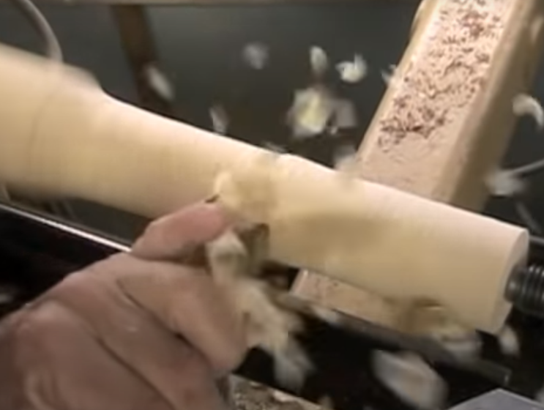
Use the roughing gouge to turn the wood into a cylinder

Slide 22
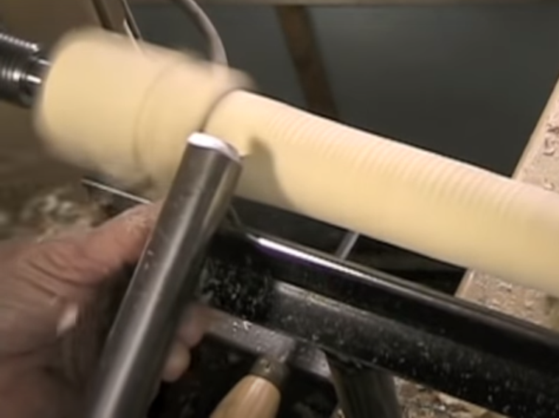
Reduce diameter required for your piece

Slide 23
Mark out features on wood using a pencil and steel rule
Ensure there is sufficient waste wood near centres

Slide 24
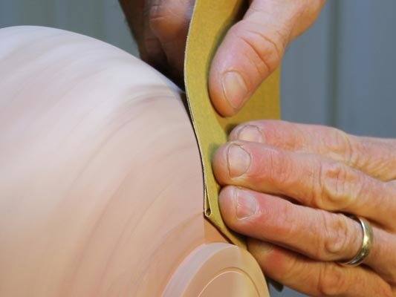
When complete, ensure a smooth surface with sand paper

Slide 25
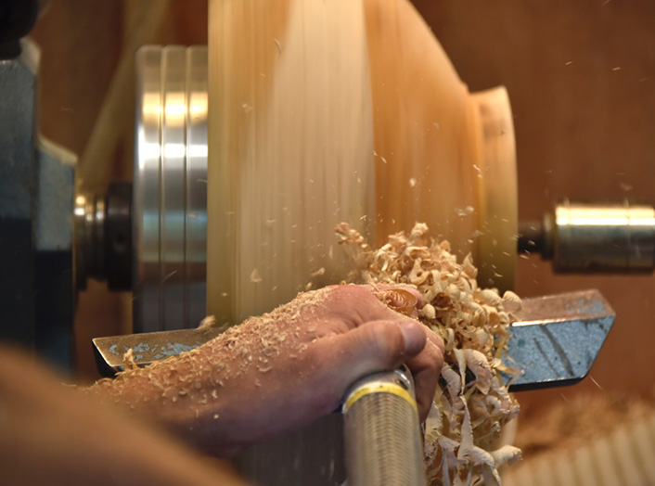
For additional smoothness, use leftover shavings. This is called “burnishing.”

Slide 26
Add varnish, wax or other finished to the wood whilst it is still on the lathe

Slide 27
Remove the pieces using the parting chisel, skew chisel or sawing

Slide 28
safety
?
https://www.youtube.com/watch?v=IiLNIM3JUlg

Slide 29
Personal safety
Wear a face shield/goggles
No loose clothing/hair
Ensure extraction is on
Hold the tools correctly
Remove debris regularly
Hands clear of faceplate/centres
There are a number of safety checks to be carried out, both on the wood lathe itself and personal safety checks.
What PERSONAL safety checks should you carry out before working on the wood lathe?

Slide 30
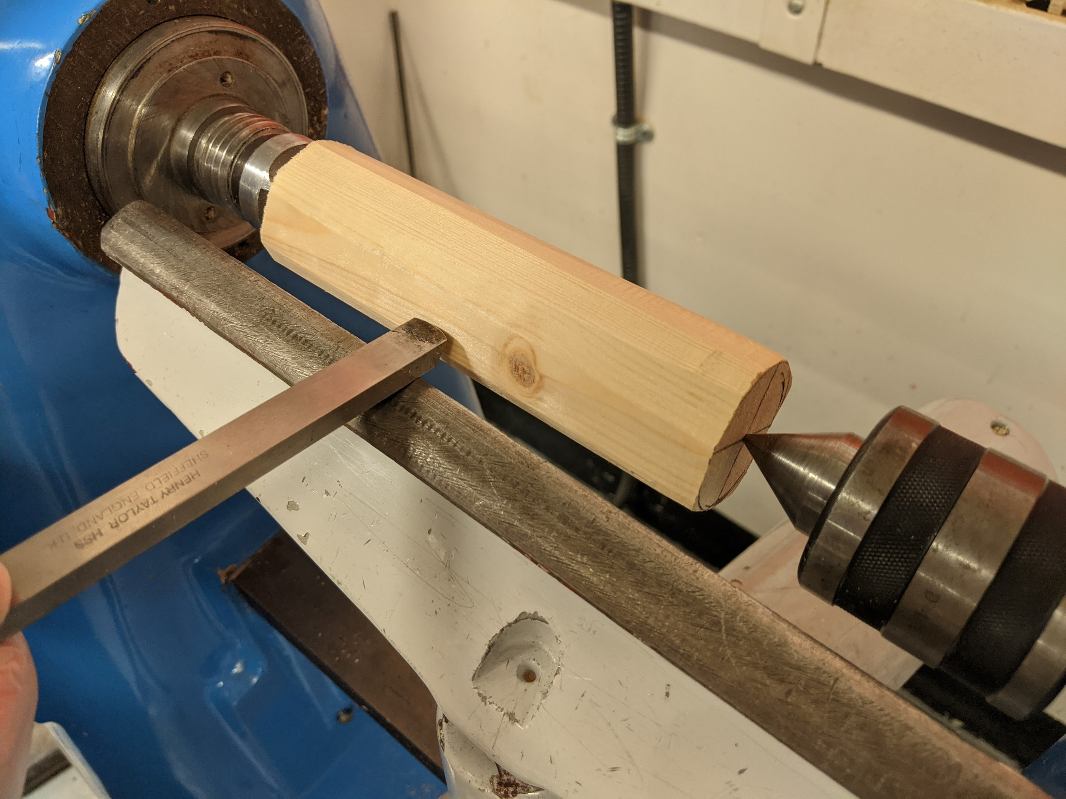
MACHINE safety
What MACHINE safety checks should you carry out before working on the wood lathe?

Slide 31
Wood is securely attached to centres

Slide 32
Small a gap as possible between wood and tool rest

Slide 33
Chisels are kept sharp to ensure a good cut and to avoid accidents

Slide 34
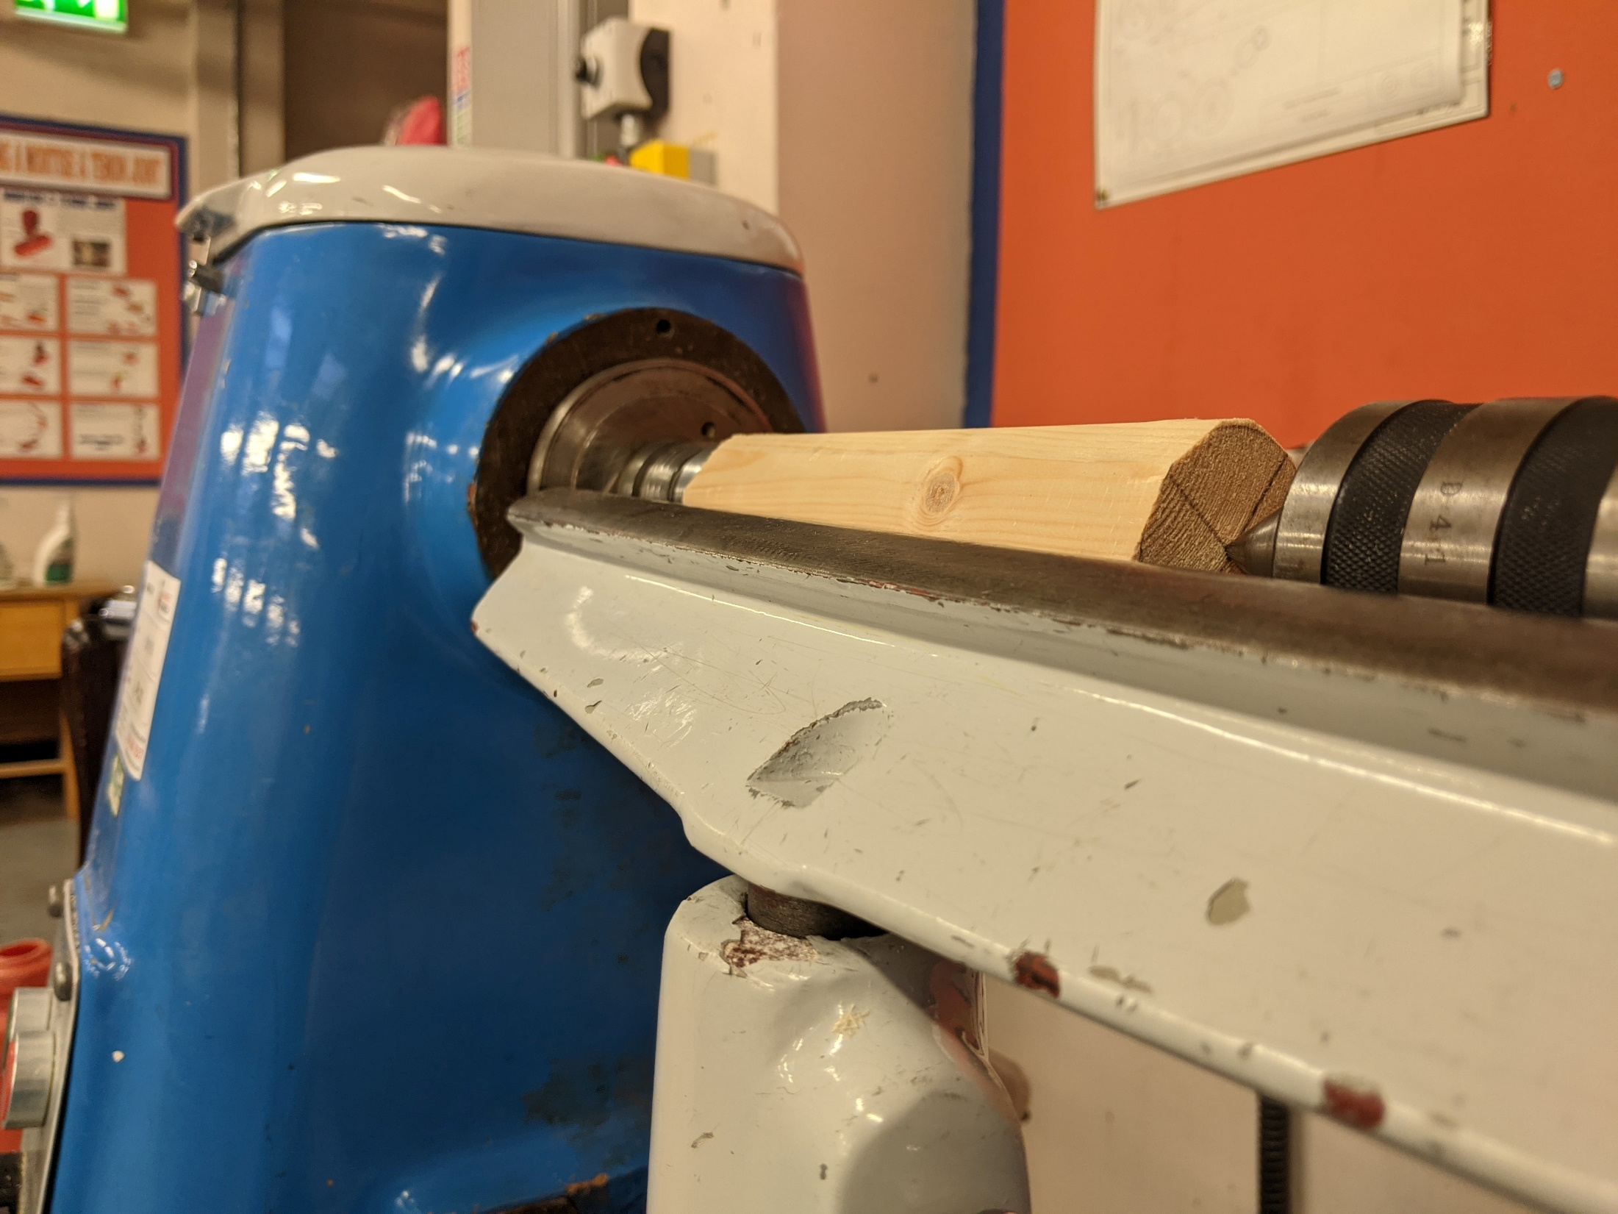
Tool rest centrally aligned with work piece

Slide 35
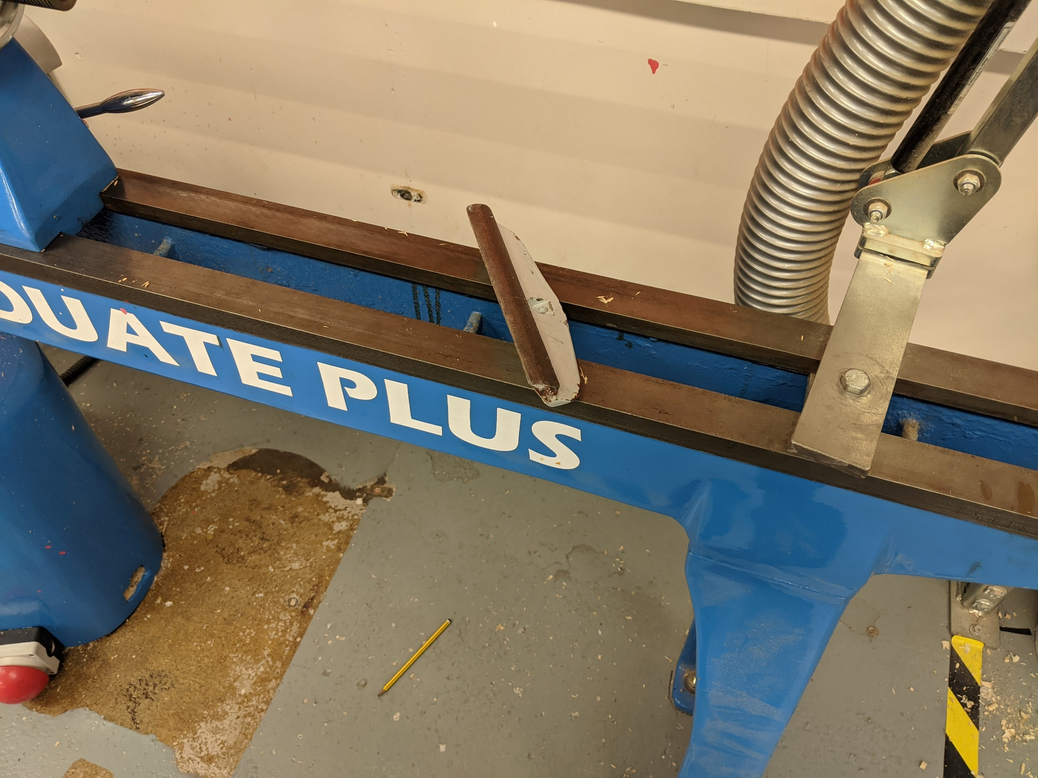
Nothing should be left on the lathe bed

Slide 36
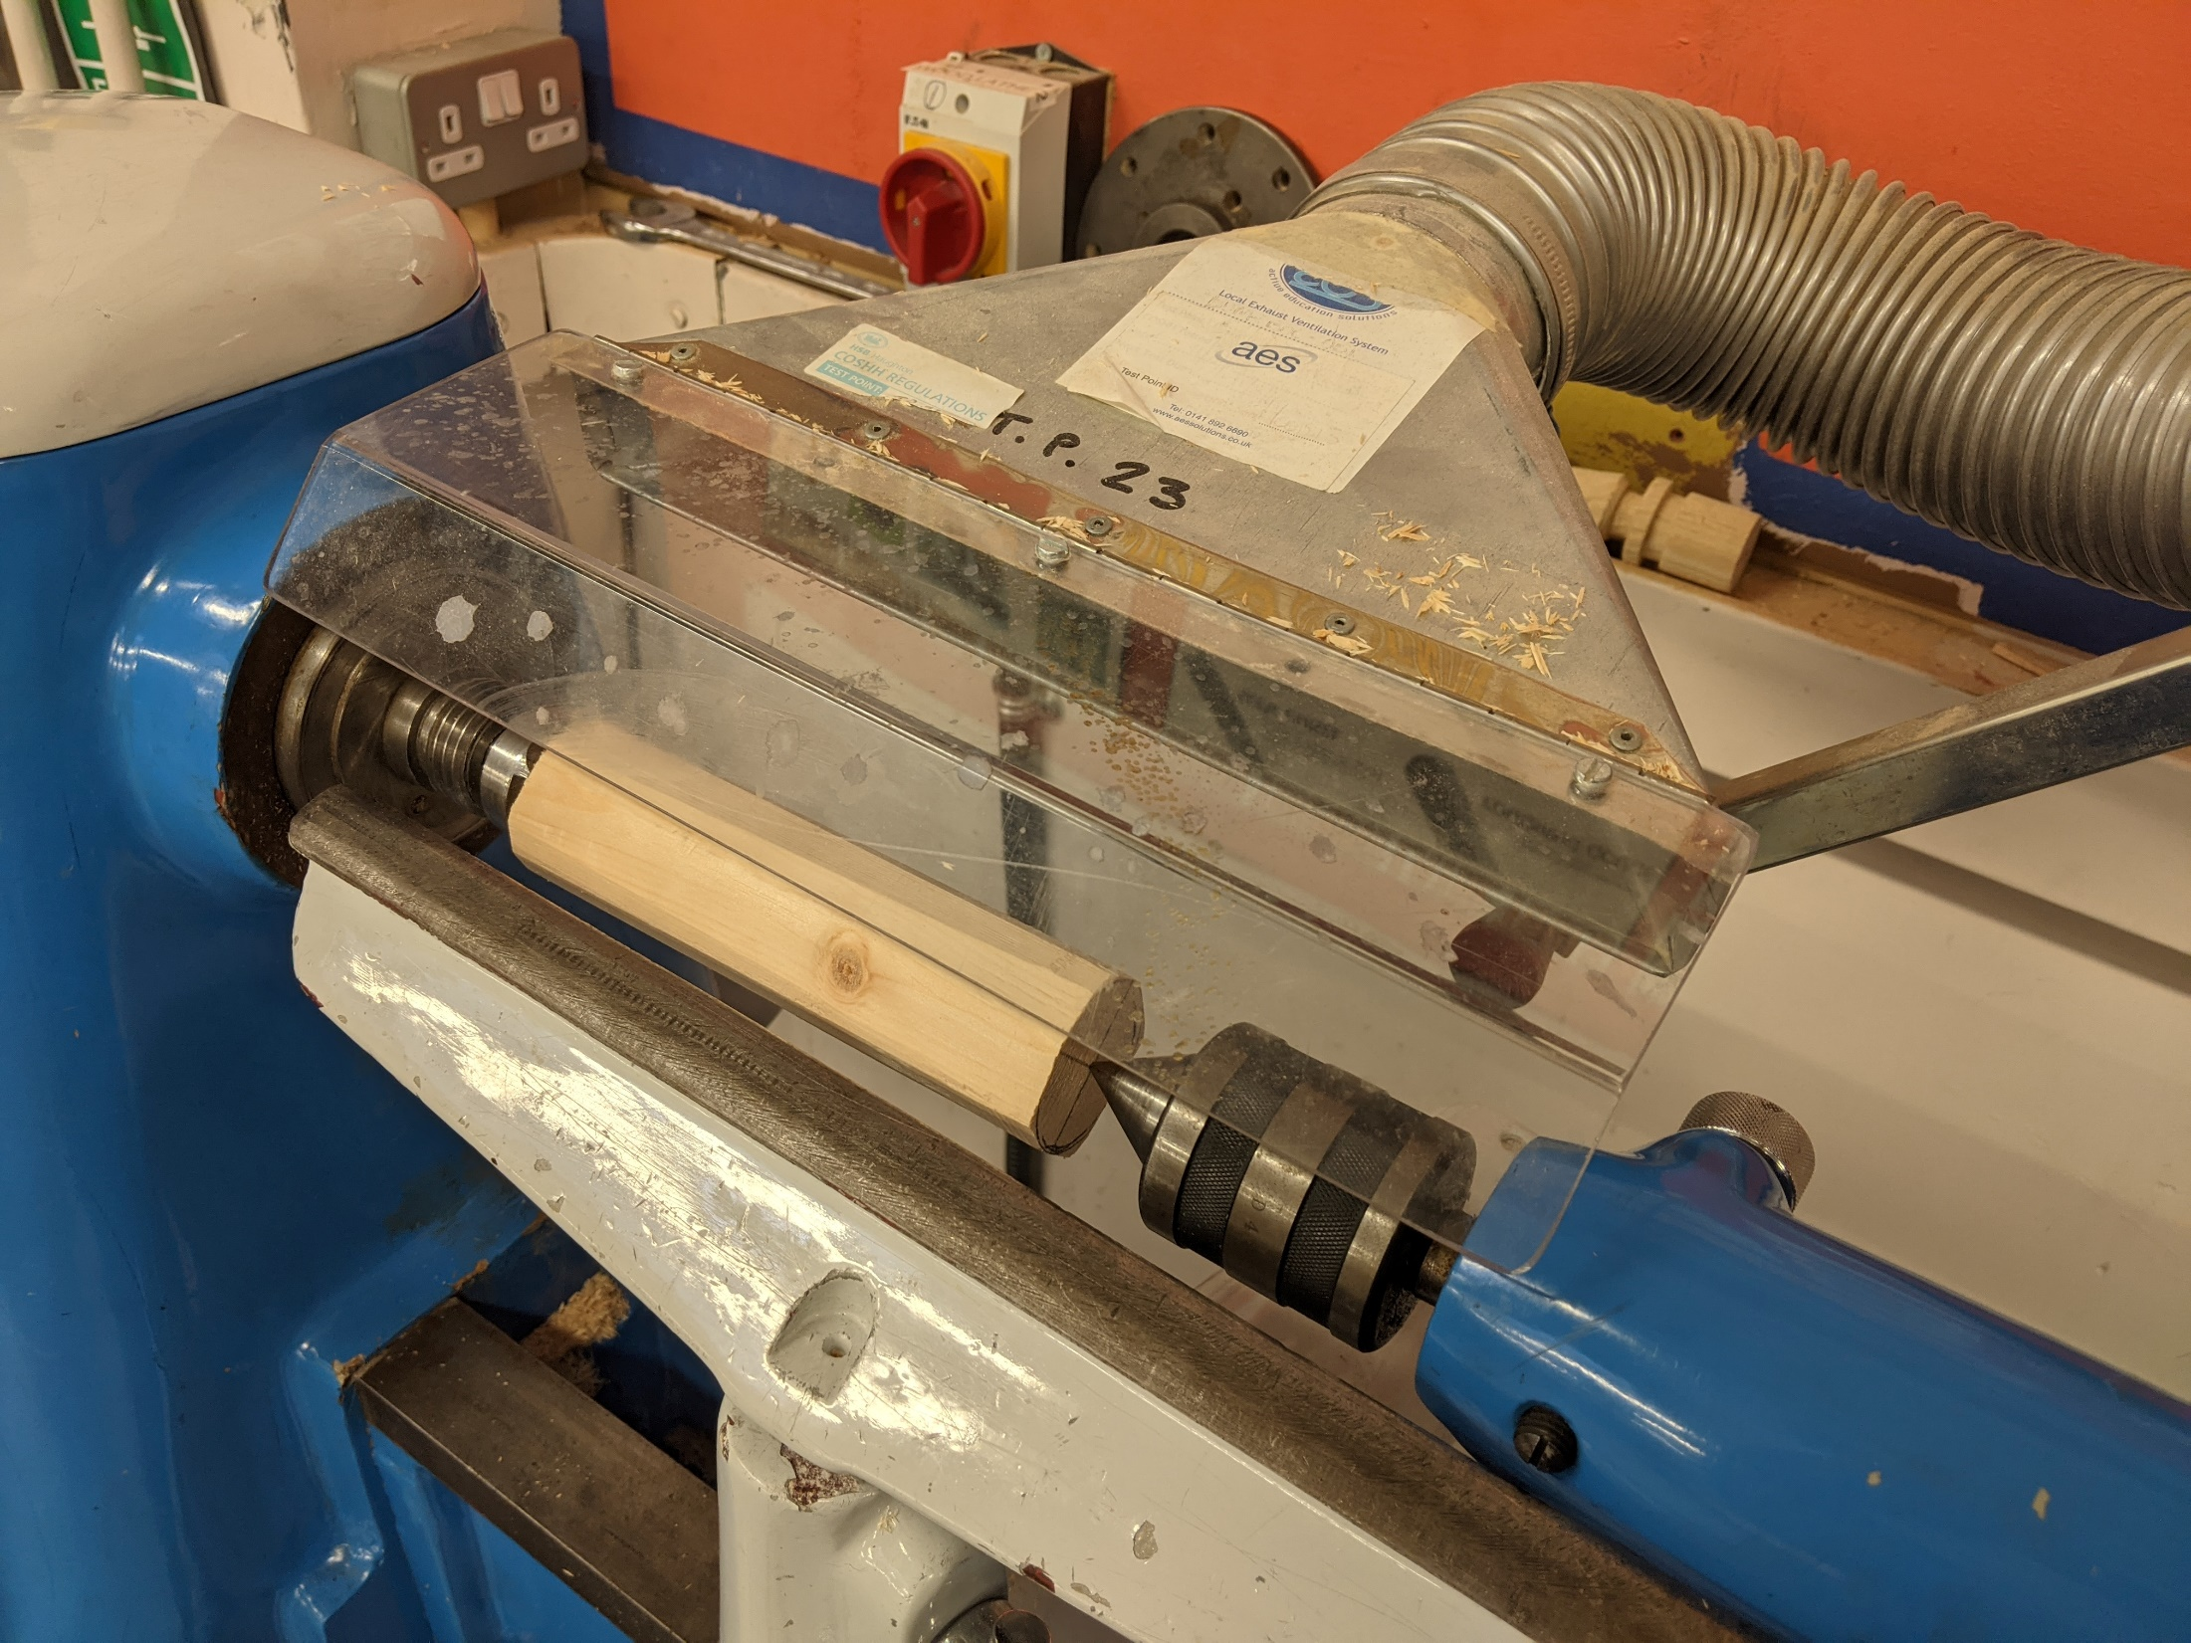
Waste Extraction should be in position

Slide 37
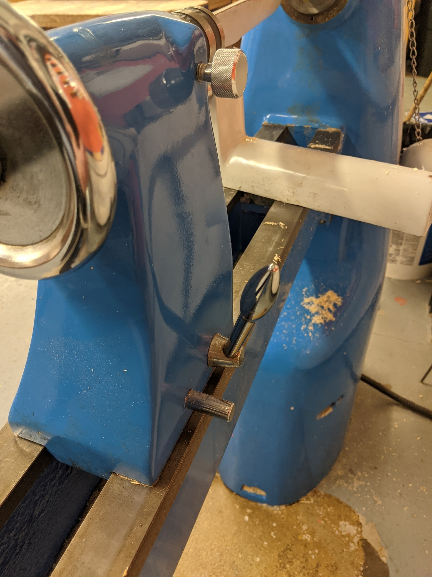
Tool rest and tail stock should be locked in position

